Slide 1
Coated Steel Production

Slide 2
Resistance Welding
Learning Activities
View Slides;
Read Notes,
Listen to lecture
Do on-line workbook
Lesson Objectives
When you finish this lesson you will understand:
Keywords

Slide 3
Types of Coated Steels
Hot Dipped Zinc Coated
  Regular & Minimized Spangle
  Fully Alloyed Iron Coated
  Differentially Coated
Electrolytic Zinc Coated
Hot Dipped Zinc Coated One Side
Electrolytic Zinc Coated One Side
Electro-Alloyed
Aluminum Coated
Long Terne
Tin Coated
Zincrometal
Notes:
Requirements for improved durability in domestic consumer goods have invariably led to the application of more corrosion-resistant materials. In many industries (automotive, furniture and appliance), the basic material for manufacture has been uncoated sheet steel. For these applications, the obvious corrosion-resistant alternative material has been some form of coated steel.
Many types of coatings are currently used for various applications, as listed in the above slide.

Slide 4
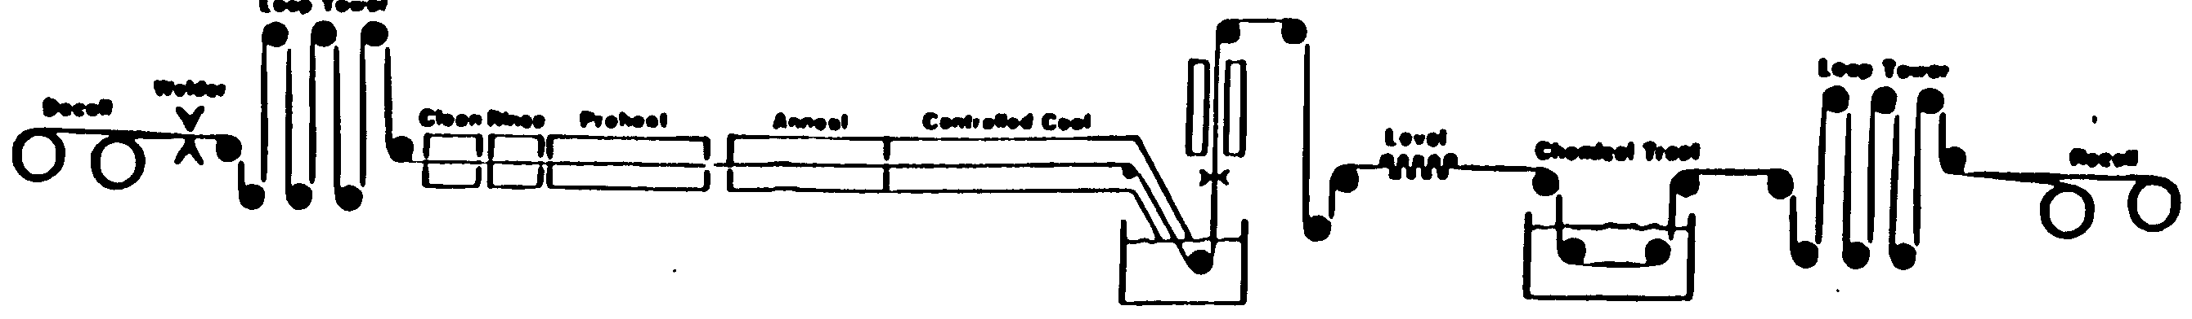
Hot-Dipped Galvanizing Process
Welder
Cooling Tower
Air Knives
Leveler
Clean
Rinse
Heat
Zinc Pot
800-1200F
Chemical Treatment (opt)
Preheat
Notes:
Hot-dipped galvanizing is a process used to apply metallic zinc coatings to sheet steel in coil form for use in the automotive industry. While the hot-dipped galvanizing process has been employed for many years by applying zinc to sheet steels for anti-corrosion purposes, process refinements, aimed at improving product quality, are continual. Basic sections of hot-dipped lines, in sequential order, are:
Strip cleaning to prepare the steel surface for coating
In-line furnaces to bring the steel up to the proper temperature for coating, and in many instances to further prepare the surface for coating and/or to partially or fully anneal the steel
Molten zinc bath to apply the coating to the steel
Air knives/dams for controlling coating weight
Cooling towers to solidify the coating.

Slide 5
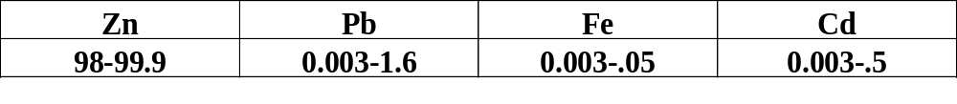
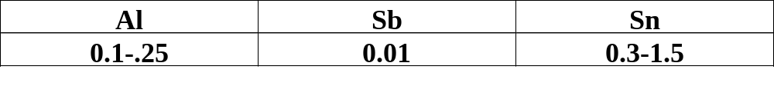

Hot-Dipped Galvanized
Increased Coating
Adherence,
Passive Layer
Aids in Wetting
Frosted Spangle
Zinc
Aluminum Oxide Passive Layer
Zinc Layer Thickness
0.13 to 1.2 oz/sq ft
0.0002 to 0.0015 in.
steel
Notes:
The chemistry of the zinc pot is listed in this slide. The major component is of course zinc, but small amounts of lead, iron and cadmium may be present to control melting temperature and flow properties of the zinc melt. In addition, several alloying elements are intentionally added for very specific purposes.
Aluminum in the range from 0.1 to 0.25 % performs two important functions. First it increases the adherence of the zinc to the steel substrate by forming a very tenacious aluminum oxide layer on the steel which also forms a strong bond to the zinc. This aluminum oxide passive layer also serves as a barrier to inter-diffusion which we will see later can be beneficial to resistance welding.
Small amounts of antimony may be added to lower surface tension and increase the wetting of the zinc to the steel.
Often the shinny large spangle galvanized appearance is not required and a more subdued frosted appearance needed. The addition of Tin to the melt produces such a frosted zinc surface coating appearance.
The layer thickness obtained is often referenced in one of two ways, I.e. either zinc layer thickness in inches or mm or in the weigh of zinc applied per square foot or meter. Typical weights range from 0.1 to 1.2 ounces per square foot. A G90 (0.9 ounces per square foot is a common commercial grade).

Slide 6
Spangle Control in Hot-Dipped Galvanizing
Air Spray
Fine Zn Dust Nucleii
600-800 micro-inches
Notes:
The surface of hot-dipped zinc coatings has historically been characterized by the appearance of large spangles (zinc crystals). In recent years, to meet the needs of automotive and other critical surface appearance applications, this appearance has been modified through zinc bath composition changes, impingement of zinc dust or steam onto the molten coating, or temper rolling (skin passing) of the coated steel. As a result, many products today have a minimized spangle or spangle-free surface appearance.

Slide 7
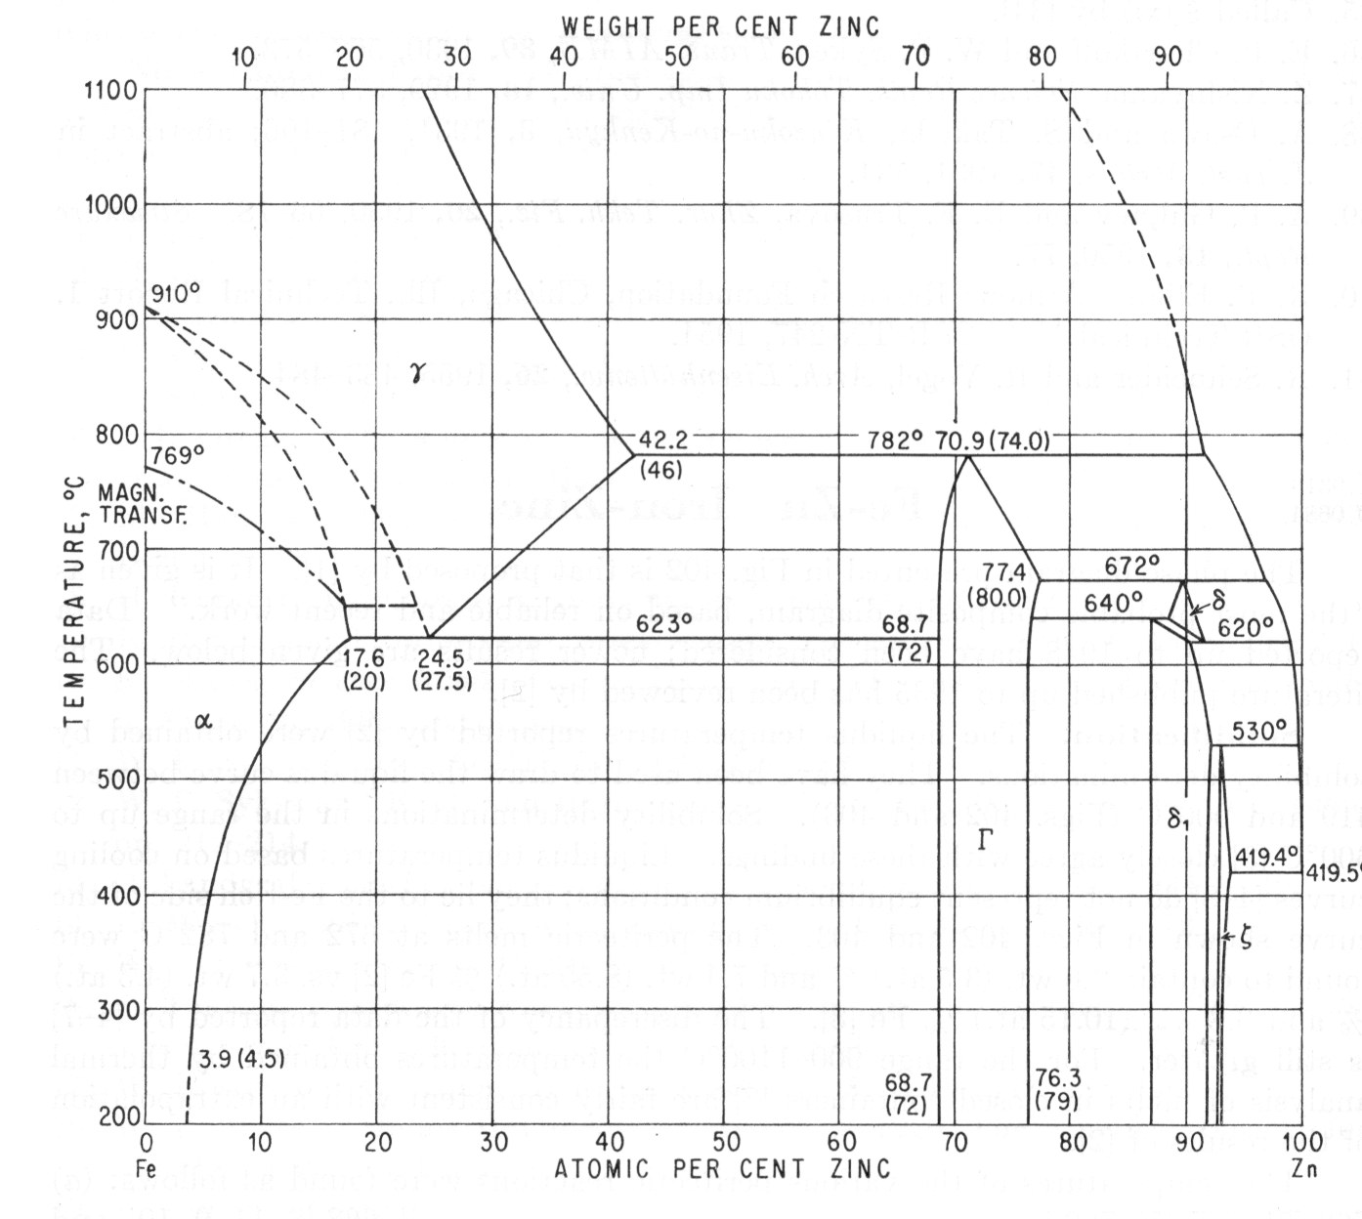
Alpha
Steel
Delta
Zeta
Gamma
Notes:
As with any materials layered together (especially when the contact is performed at high or even above the melting temperature of one of the components) inter-diffusion is expected. In alloys where intermediate phases are possible, the equilibrium phase diagram can be used to estimate the presence of the various phases which might form. In the case of iron-zinc the following phases might be present across the interface from the iron to the top of the zinc coating: Alphas Steel, Gamma, Delta, Zeta, and Zinc.

Slide 8
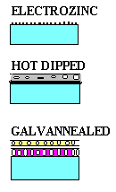
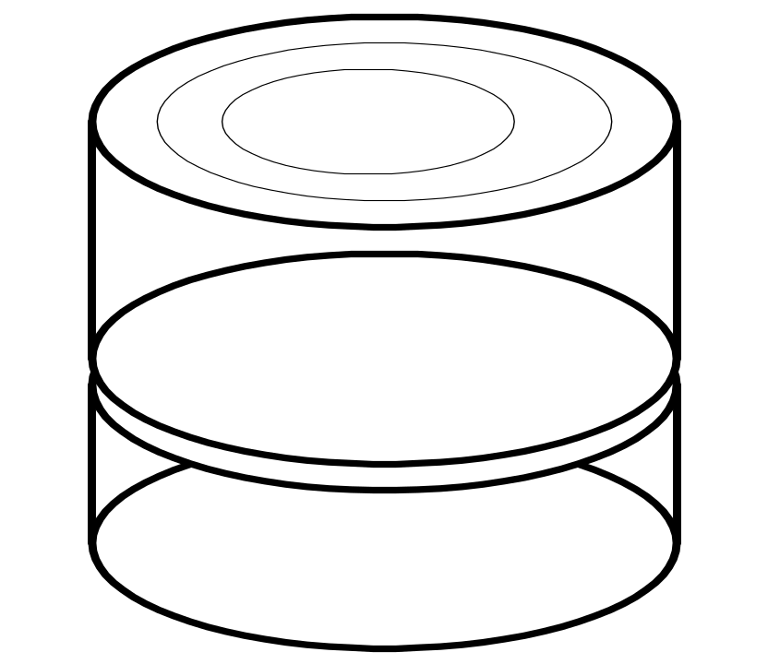
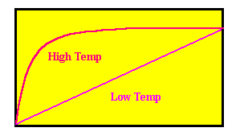
Annealing Furnace
Annealing Furnace
In Line Furnace
Hot Dipped
Galvannealed
Zeta
Delta
Gamma
Thickness
Steel
Time
Notes:
By in-line heating of the molten coating shortly after it exits from the bath, or by batch annealing of the coiled product, additional inter-diffusion of the iron and zinc atoms will occur, and the zinc coating can be transformed into an alloyed zinc-iron coating via diffusion with the steel substrate. As shown on this diagram, the thickness growth of the alloy layers will increase with both time and increased temperature. Coatings in which this alloy layer is promoted are called galvannealed coated steels.

Slide 9

Questions?

Slide 10
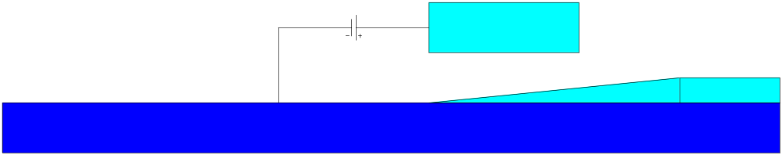
Electro-Galvanizing Process
Zinc Anode
Surface Clean
100-200 micro-inch
Zinc Sulfate Bath
Steel Cathode
Cold Process, no alloying, no change in substrate
Very Smooth Surface
Can Also Tin Plate Using Tin Anode and Sodium Stannate Bath
Notes:
The electrogalvanizing process is a relatively recent development, compared to the hot-dipped process. In this process, the metallic coating is deposited onto the steel (cathode) via electrolytic deposition of metal ions from an electrolyte solution. While different process technologies are available, common to all are cleaning sections followed by a series of plating cells. In contrast to the hot-dipped process, electrogalvanizing is a low temperature process (~100 to 150F) and coating weight is controlled via the main process parameters of line speed and current density. In addition to “pure” zinc coatings, zinc-alloy coatings can be applied via co-depositing of zinc and other elements (such as iron or nickel) from the electrolyte onto the steel surface.
Due to the nature of the processes, coating weight is more easily controlled in the electrolyte compared to the hot-dipped process. While both processes are capable in certain instances of producing materials of exposed, semi-exposed and unexposed surface quality, hot-dipped products are usually employed in unexposed and semi-exposed application, and electrolytic products in semi-exposed and exposed applications.

Slide 11
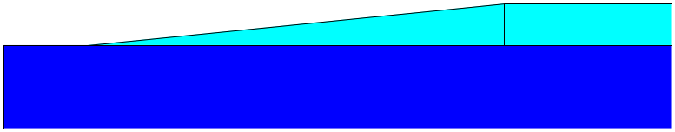
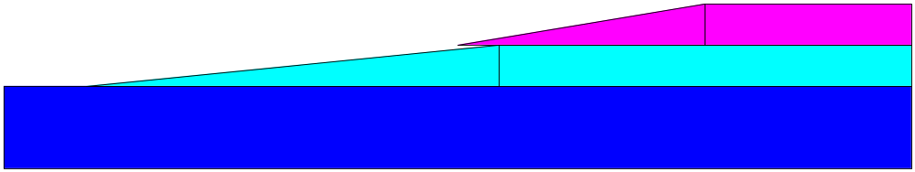
Electro-Alloy
9%Fe - Zn
23%Fe - Zn
30%Fe - Zn
20%Ni - Zn
27%Ni - Zn
Electro-Duplex
Multiple Layers
Zn, Zn Alloys, Sn
Electro-Coating Variations
Notes:
The electro-coating process can also be used to develop coatings with various alloy content as illustrated here by simply changing the alloy content of the sacrificial anode electrode. In addition, by having multiple anodes successively along the plating tank as the strip is processed through the tank, a duplex multiple layer of very different coatings can be electrolytically produced.

Slide 12
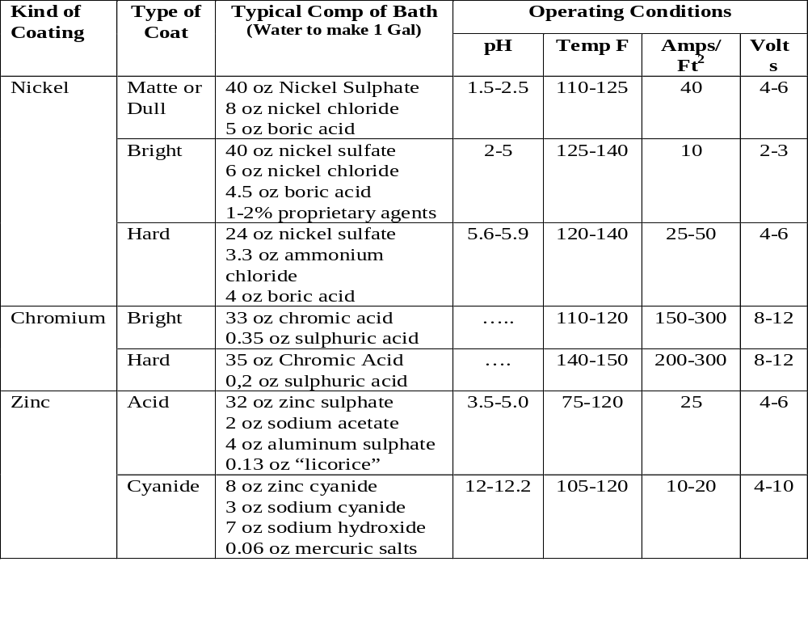
Making & Shaping of Steel,
USS, 1964
Notes:
This table lists the operating conditions for the production of electrolytic coatings on steel. Note that there are several variations in the process for application of zinc which can be selected.

Slide 13
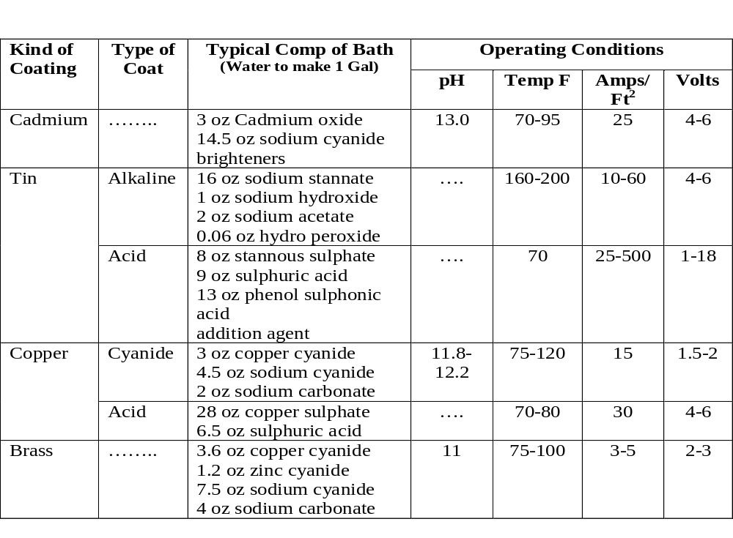
Making & Shaping of Steel,
USS, 1964
Notes:
Other electrolytic coating are possible as well as listed in this table. Some of these will be considered later in this course.

Slide 14
GALVANIZED
STEEL
METALLURGY
COMPARISON
Zinc
Steel
Zinc
Alloy Layer
Steel
Zeta
Delta
Gamma
Thickness
Steel
Time
Notes:
The above comparison of the various zinc coating techniques are illustrated here. The electrolytic coating is generally thin and has pure zinc coating. Because it is applied cold, there is little or no alloying with the substrate and generally no spangle appearance. The hot dipped material has a zinc top coating in which spangle s are noted (the size of which is controlled by the processing parameters) and may have an alloy layer depending upon the presence or absence of the aluminum oxide passive layer. The galvannealed has extensive alloy layers and may have no free zinc on the top surface at all depending on the time-temperature exposure of the alloy growth process.

Slide 15
Questions?

Slide 16
Typical Applications of Coated Steels
Hot Dipped Zinc Coated
  Rocker panels
  B posts
  Wheelhouse outer panels
  Cowl top panels
  Luggage compartment floor pans
Electrolytic Zinc Coated
  Window guides
  Wiper blade frames
  Radio speaker baskets
  Head rest supports
Zincrometal
  Doors
  Front fenders
  Quarter panels
Notes:
[Hot Dipped Zinc Coated]
Regular & Minimized Spangle: This product is made on continuous hot-dip galvanizing lines and is supplied in coils and cut lengths. The product includes regular and minimized spangle in a wide range of coating designations (ASTM A525) and is available in extra smooth finish.
Fully Alloyed Iron Coated: This product may be heat treated or wiped to produce a fully alloyed zinc-iron coating.
Differentially Coated: This product may also be produced with a specified coating weight on one surface and a significantly lighter coating weight on the other -- referred to as differentially coated.
[Electrolytic Zinc Coated] Electrolytic zinc coated steel is produced by continuous electroplating with zinc -- 0.1 to 0.2 oz. per square foot total on both sides. It is used when minimal corrosion resistance is required and when components are more difficult to form.
[Aluminum Coated] Aluminum coated steel is produced by hot-dip coating cold rolled sheet steel on continuous lines. It provides a material with the superior strength of steel and the surface properties of aluminum.
[Long Terne] Long terne is cold rolled sheet steel coated on both sides with a lead-tin alloy by a continuous hot-dip process.

Slide 17
Typical Applications of Coated Steels (CONT.)
Hot Dipped Zinc Coated One Side
  Fenders
  Door outer panels
  Rear quarter panels
  Deck opening lower panels
Electrolytic Zinc Coated One Side
  Door outer panel
  Rear quarter panels
  Fenders
  Deck lids
  Lower back panels
Notes:
[Hot Dipped Zinc Coated One Side] This product is produced with a continuous hot dipped zinc coating on one side of the sheet and a zinc free cold rolled steel surface on the other.
[Electrolytic Zinc Coated One Side] This product is produced by coating one side of a steel sheet with a smooth matter finish of electro deposited zinc for corrosion resistance. The other side is a standard cold rolled surface which has superior paintability.
[Tin Coated] This product is cold rolled sheet steel coated with tin by a continuous electrolytic process.
[Zincrometal] This product is a cold rolled sheet product with a zinc rich productive coating applied by the coil coating process, generally to only one side.

Slide 18

Homework

